Slide 1
Data Management for Data Science
Lecture 3: Principles of Data Management
Prof. Asoc. Endri Raço

Slide 2
Today’s Lecture
Data Management
Data Models
RDBMs and the Relational Data Model

Slide 3
1. Data Management
Section 1

Slide 4
Data Management
Section 1
Data represents the traces of real-world processes.
Data is valuable but hard and costly to manage
Storage, representation complexity, collection
Data management seeks to answer two questions:
What operations do we want to perform on this data?
What functionality do we need to manage this data?

Slide 5
Required Functionality
Section 1
Describe real-world entities in terms of stored data
Create & persistently store large datasets
Efficiently query & update
Must handle complex questions about the data
Must handle sophisticated updates
Performance matters
Change structure (e.g., add attributes)
Concurrency control: enable simultaneous queries, updates etc
Crash recovery
Access control, security, integrity
It is difficult and costly to implement all these features!

Slide 6
Systems providing data management features
Section 1
Relational database management systems
HDFS-based systems (e.g., hadoop)
Stream management systems: Apache Kafka
Others?

Slide 7
Section 1

Slide 8
2. Data Models
Section 2

Slide 9
What you will learn about in this section
Section 2
Types of Data
Data Models

Slide 10
Data is highly heterogeneous
Section 2
Structured data
Semi-structured data
Unstructured data
Increasing amounts of data

Slide 11
Structured data
Section 2
Information with a high degree of organization
All data conforms to a schema. Ex: business data
Easy to query, search over, aggregate
Example: tables in a database, tables in excel, etc.

Slide 12
Semi-structured data
Section 2
Some structure in the data but implicit and irregular
It contains tags or other markers to separate semantic elements and enforce hierarchies of records and fields within the data
Example: JSON, HTML, XML

Slide 13
Unstructured data
Section 2
Information that either does not have a pre-defined structure or is not organized in a pre-defined manner.
Text, video, images, etc.
Abundant and extremely valuable. Hard to query, aggregate, analyze, search.

Slide 14
Data Model
Section 2
A data model is a collection of concepts for describing data
A schema is a description of a particular collection of data, using the given data model
A data model enables users to define the data using high-level constructs without worrying about many low-level details of how data will be stored on disk.

Slide 15
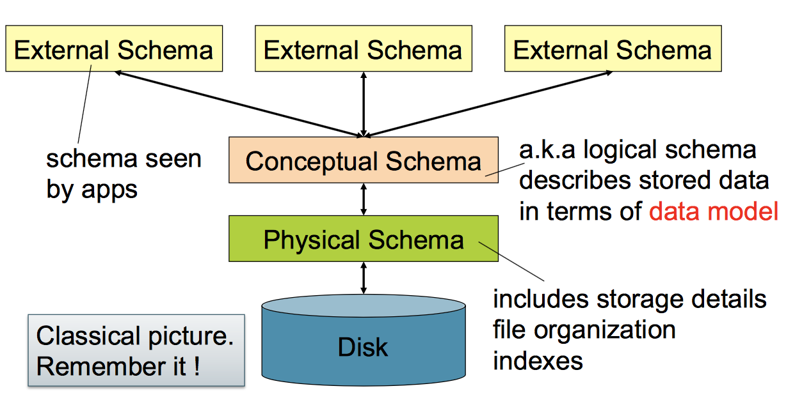
Levels of abstraction
Section 2

Slide 16
Data models
Section 2
Relational
Key/Value
Graph
Document
Column-family
Array/Matrix
Hierarchical
Network
Most database management systems

Slide 17
Data models
Section 2
Relational
Key/Value
Graph
Document
Column-family
Array/Matrix
Hierarchical
Network
No SQL

Slide 18
Data models
Section 2
Relational
Key/Value
Graph
Document
Column-family
Array/Matrix
Hierarchical
Network
Machine learning, Scientific applications

Slide 19
Data models
Section 2
Relational
Key/Value
Graph
Document
Column-family
Array/Matrix
Hierarchical
Network
Obsolete / Rare

Slide 20
3. RDBMs and the Relational Data Model
Section 3

Slide 21
What you will learn about in this section
Section 3
Definition of DBMS
Data models & the relational data model
Schemas & data independence

Slide 22
What is a DBMS?
Section 3
A large, integrated collection of data
Models a real-world enterprise
Entities (e.g., Students, Courses)
Relationships (e.g., Alice is enrolled in CS564)
A Database Management System (DBMS) is a piece of software designed to store and manage databases

Slide 23
A Motivating, Running Example
Section 3
Consider building a course management system (CMS):
Students
Courses
Professors
Who takes what
Who teaches what
Entities
Relationships

Slide 24
Data models
Section 3
A data model is a collection of concepts for describing data
The relational model of data is the most widely used model today
Main Concept: the relation- essentially, a table
A schema is a description of a particular collection of data, using the given data model
E.g. every relation in a relational data model has a schema describing types, etc.

Slide 25
Modeling the Course Management System
Section 3
Logical Schema
Students(sid: string, name: string, gpa: float)
Courses(cid: string, cname: string, credits: int)
Enrolled(sid: string, cid: string, grade: string)
sid | Name | Gpa
101 | Bob | 3.2
123 | Mary | 3.8
Relations
cid | cname | credits
564 | 564-2 | 4
308 | 417 | 2
Students
sid | cid | Grade
123 | 564 | A
Courses
Enrolled

Slide 26
Modeling the Course Management System
Section 3
Logical Schema
Students(sid: string, name: string, gpa: float)
Courses(cid: string, cname: string, credits: int)
Enrolled(sid: string, cid: string, grade: string)
sid | Name | Gpa
101 | Bob | 3.2
123 | Mary | 3.8
Corresponding keys
cid | cname | credits
564 | 564-2 | 4
308 | 417 | 2
Students
sid | cid | Grade
123 | 564 | A
Courses
Enrolled

Slide 27
Other Schemata…
Section 3
Physical Schema: describes data layout
Relations as unordered files
Some data in sorted order (index)
Logical Schema: Previous slide
External Schema: (Views)
Course_info(cid: string, enrollment: integer)
Derived from other tables
Administrators
Applications

Slide 28
Data independence
Section 3
Concept: Applications do not need to worry about how the data is structured and stored
Logical data independence: protection from changes in the logical structure of the data
I.e. should not need to ask: can we add a new entity or attribute without rewriting the application?
Physical data independence: protection from physical layout changes
I.e. should not need to ask: which disks are the data stored on? Is the data indexed?
One of the most important reasons to use a DBMS

Slide 29
Relational Model
Section 3
Structure: The definition of relations and their contents.
Integrity: Ensure the database’s contents satisfy constraints.
Manipulation: How to access and modify a database’s contents.

Slide 30
Tables in the Relational Model
Section 3
A relation or table is a multiset of tuples having the attributes specified by the schema
Product
PName | Price | Manufacturer
Gizmo | $19.99 | GizmoWorks
Powergizmo | $29.99 | GizmoWorks
SingleTouch | $149.99 | Canon
MultiTouch | $203.99 | Hitachi
Let’s break this definition down

Slide 31
Tables in the Relational Model
Section 3
A multiset is an unordered list (or: a set with multiple duplicate instances allowed)
Product
PName | Price | Manufacturer
Gizmo | $19.99 | GizmoWorks
Powergizmo | $29.99 | GizmoWorks
SingleTouch | $149.99 | Canon
MultiTouch | $203.99 | Hitachi
List: [1, 1, 2, 3]
Set: {1, 2, 3}
Multiset: {1, 1, 2, 3}
i.e. no next(), etc. methods!

Slide 32
Tables in the Relational Model
Section 3
Product
An attribute (or column) is a typed data entry present in each tuple in the relation
PName | Price | Manufacturer
Gizmo | $19.99 | GizmoWorks
Powergizmo | $29.99 | GizmoWorks
SingleTouch | $149.99 | Canon
MultiTouch | $203.99 | Hitachi
Attributes must have an atomic type, i.e. not a list, set, etc.

Slide 33
Tables in the Relational Model
Section 3
Product
PName | Price | Manufacturer
Gizmo | $19.99 | GizmoWorks
Powergizmo | $29.99 | GizmoWorks
SingleTouch | $149.99 | Canon
MultiTouch | $203.99 | Hitachi
A tuple or row is a single entry in the table having the attributes specified by the schema
Also referred to sometimes as a record

Slide 34
Tables in the Relational Model
Section 3
Product
PName | Price | Manufacturer
Gizmo | $19.99 | GizmoWorks
Powergizmo | $29.99 | GizmoWorks
SingleTouch | $149.99 | Canon
MultiTouch | $203.99 | Hitachi
The number of tuples is the cardinality of the relation
The number of attributes is the arity of the relation
n-ary Relation = Table with n columns

Slide 35
Data Types in Relational Model
Section 3
Atomic types:
Characters: CHAR(20), VARCHAR(50)
Numbers: INT, BIGINT, SMALLINT, FLOAT
Others: MONEY, DATETIME, …
Every attribute must have an atomic type
Hence tables are flat

Slide 36
Table Schemas
Section 3
The schema of a table is the table name, its attributes, and their types:
A key is an attribute whose values are unique; we underline a key
Product(Pname: string, Price: float, Category: string, Manufacturer: string)
Product(Pname: string, Price: float, Category: string, Manufacturer: string)

Slide 37
Key constraints
Section 3
A key is a minimal subset of attributes that acts as a unique identifier for tuples in a relation
A key is an implicit constraint on which tuples can be in the relation
i.e. if two tuples agree on the values of the key, then they must be the same tuple!
Students(sid:string, name:string, gpa: float)
1. Which would you select as a key?
2. Is a key always guaranteed to exist?
3. Can we have more than one key?

Slide 38
NULL and NOT NULL
Section 3
To say “don’t know the value” we use NULL
NULL has (sometimes painful) semantics, more details later
Students(sid:string, name:string, gpa: float)
sid | name | gpa
123 | Bob | 3.9
143 | Jim | NULL
Say, Jim just enrolled in his first class.
We may constrain a column to be NOT NULL, e.g., “name” in this table

Slide 39
Foreign Key constraints
Section 3
A foreign key specifies that an attribute from one relation has to map to a tuple in another relation.

Slide 40
Foreign Key constraints
Section 3
Suppose we have the following schema:
And we want to impose the following constraint:
‘Only real students may enroll in courses’ i.e. a student must appear in the Students table to enroll in a class
Students(sid: string, name: string, gpa: float)
Enrolled(student_id: string, cid: string, grade: string)
Students
Enrolled
student_id alone is not a key- what is?
sid | name | gpa
101 | Bob | 3.2
123 | Mary | 3.8
student_id | cid | grade
123 | 564 | A
123 | 537 | A+
We say that student_id is a foreign key that refers to Students

Slide 41
Summary of Schema Information
Section 3
Schema and Constraints are how databases understand the semantics (meaning) of data
They are also useful for optimization

Slide 42
DATA MANIPULATION LANGUAGES (DML)
Section 3
How to store and retrieve information from a database.
Procedural: The query specifies the (high-level) strategy the DBMS should use to find the desired result.
We will see SQL and Relational Algebra

